Slide 1

KRONOS
Time Currency
David Guez
david@guez.org
www.kronos.money

Slide 2
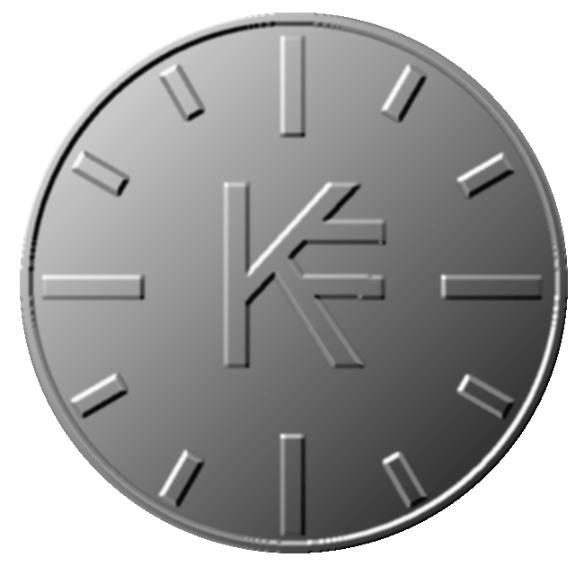
THE FACTS
Our financial system is based on principles of growth, borrowing and debt repayment.
Our needs to survive (food, transport, schelter..) makes us prisoners of the banking system and its devious effects it has on our way of living, understanding the world and exchanging goods and services.

Slide 3
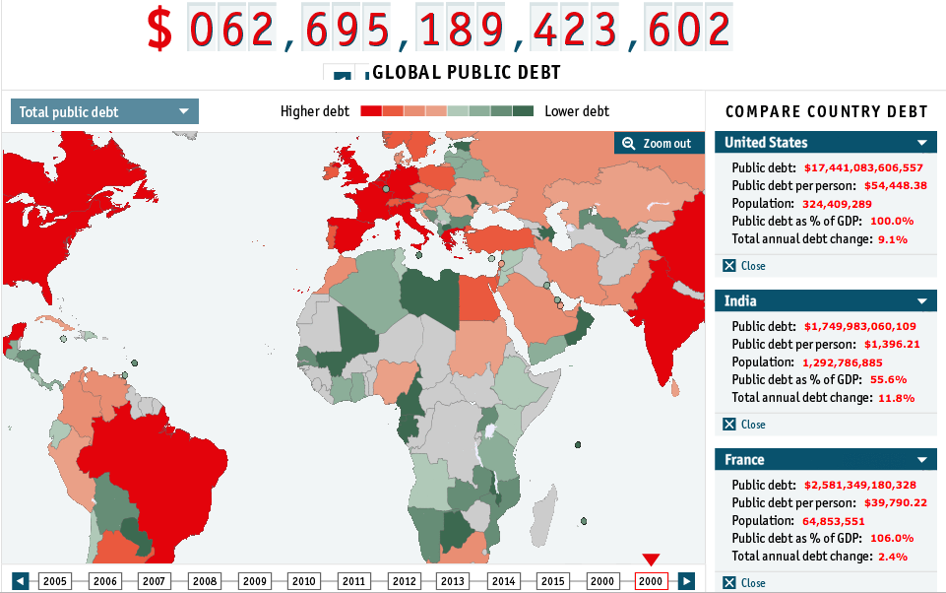

Slide 4

THE KRONOS PROJECT
A new global exchange paradigm
Instead of basing the currency on inflation or deflation of an artificial value, Kronos substitute this value with the one which really governs these exchanges :
THE HUMAN TIME
1 KRONOS = 1 HOUR
It’s the time we spend to do, to create, to built, to teach...
Everyone has the same ‘day by day’ capital of time.
it’s pushing the idea of making an equivalence between all activities

Slide 5
HOW TO CREATE A GLOBAL CURRENCY ?
We need
A complete decentralised and secure exchange system.
An exchange platform which is fair, equitable, holistic and can built trust between people.

Slide 6
CRYPTO CURRENCY & BLOCKCHAIN
The Blockchain principles are the same as the peer to peer philosophy and can be the good system to create Kronos.
Decentralised, trustable, autonomous, security.

Slide 7
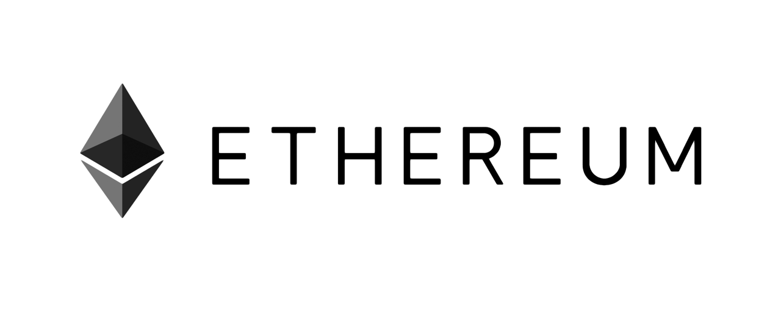
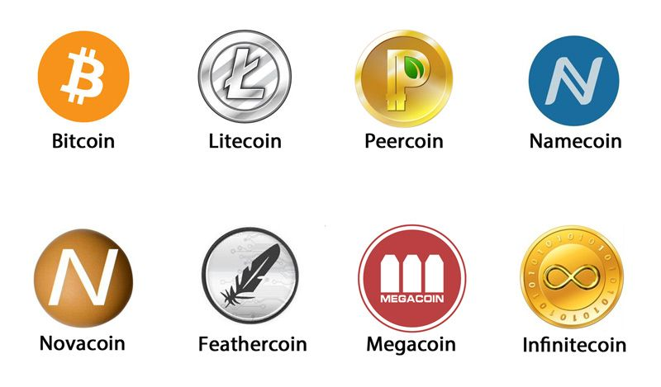
CRYPTO CURRENCY & BLOCKCHAIN
Bitcoin (1.0) <---> Ethereum (2.0)
We can fork any open source crypto currency and make our own -- > blckchain 1.0
We can create some smart contracts (programs) with an ethereum’like system --> blckchain 2.0

Slide 8
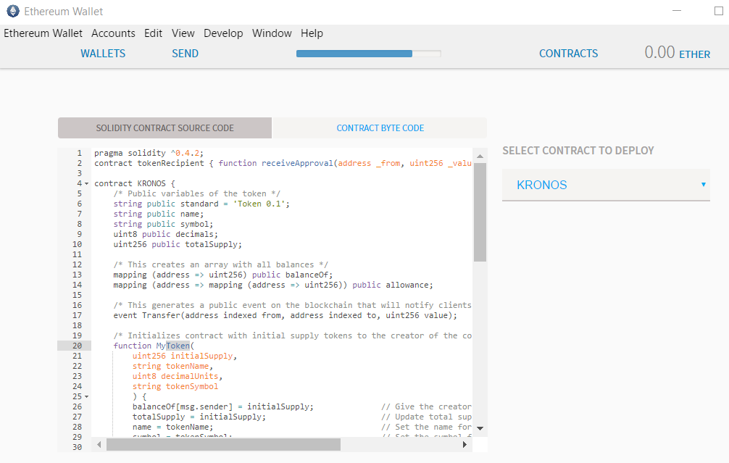
ETHEREUM
Kronos smart contract

Slide 9
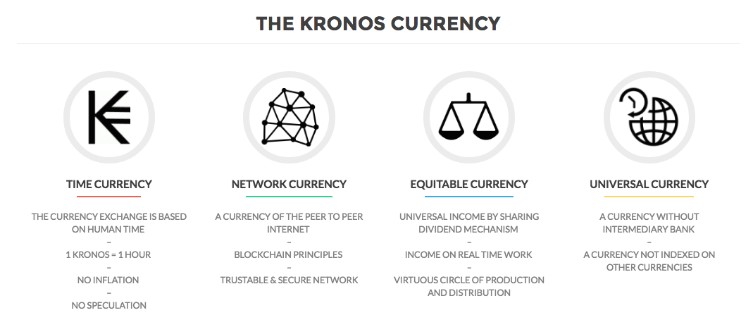

Slide 10
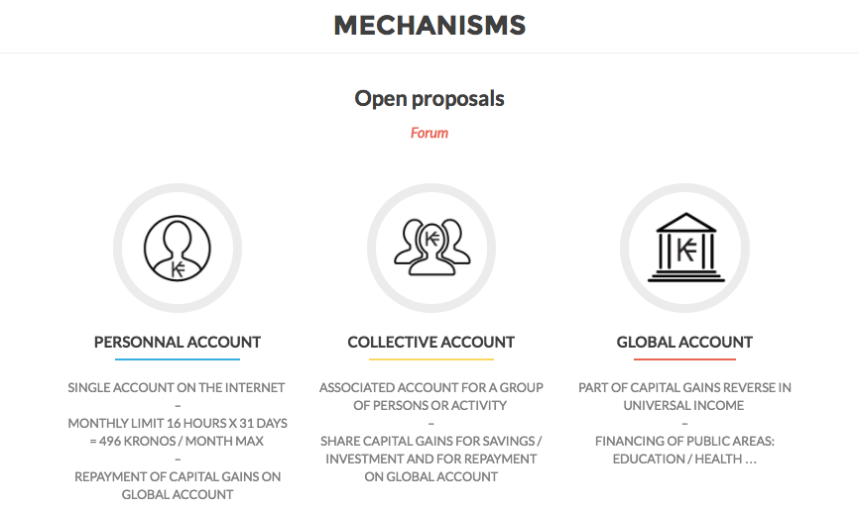

Slide 11
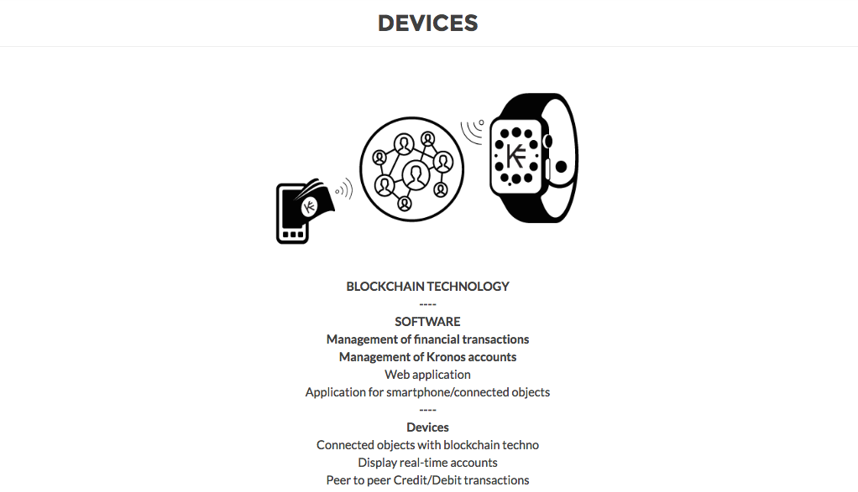

Slide 12
Consequences
THE KRONOS brings the concept of work and its monetary equivalent by replacing it with the human activity and temporal equity.
THE KRONOS is indexed on human time, in that it is completely egalitarian and prevent speculation.
THE KRONOS challenges the notion of property and replace it with the notion of objects using value.
THE KRONOS creates virtuous circles of human activity.
THE KRONOS replaces the notion of social class by the notion of creators and users class.
THE KRONOS establishes an equivalence between all activities, enabling unprecedented passages being impossible with paper money.
THE KRONOS is in a logic of common goods.

Slide 13
Questions
How to estimate a common good like bread or unit elements made from large group of people (industry)?
1 kronos = 1H but some objects or services need less → cutting into minutes // xx,xx Kronos ?
How to estimate an object like an art object : a book or a song or a paintings for example ? the idea of the evaluation of time of work // trust
Who will decide of the rules and regulation of Kronos system ? Questions of Governance
How to share all the kronos which are above the average mensual UNIT ? is it the code who decide or humans ?

Slide 14
THANKS !!!
David Guez
david@guez.org
www.guez.org
Kronos Money
www.kronos.money
HELP IS WELCOME TO CODE KRONOS !!!

